Slide 1
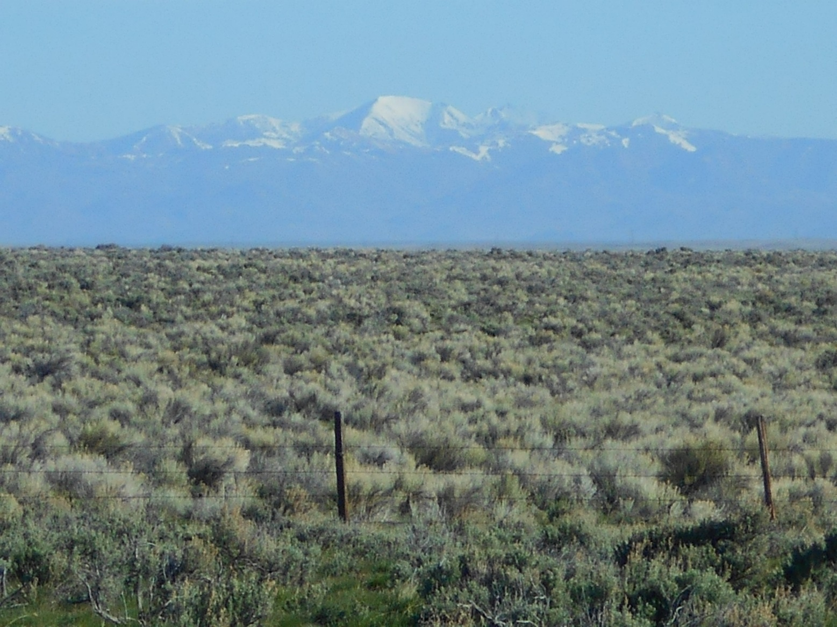
Visibility Discussion
August 1, 2018 9-11 am
WRAP TSC/Co-Chairs Call

Slide 2
Visibility and the Regional Haze Rule
Purpose of Call and Discussion
Provide common understanding of visibility and regional haze planning activities
Share work to date by Work Groups/Subcommittees
Identify framework to account for international and prescribed fire contributions
Revising natural conditions estimates
Provide additional opportunities for coordination/collaboration between Work Groups
Identify path forward and timing needs

Slide 3
Visibility and the Regional Haze Rule
Discussion Topics
Overview of Visibility and the Regional Haze Rule – Frank
Evaluation of E3 threshold - Ryan
Adjusting for international and prescribed fire emissions – Tom
Natural Conditions estimates - Pat
Technical support – Tom
Next steps - Frank

Slide 4
Visibility and the Regional Haze Rule
Application of Visibility Metric
To track changes in visibility over time
Establish source-receptor relationships
Needed to determine reasonable progress goals

Slide 5
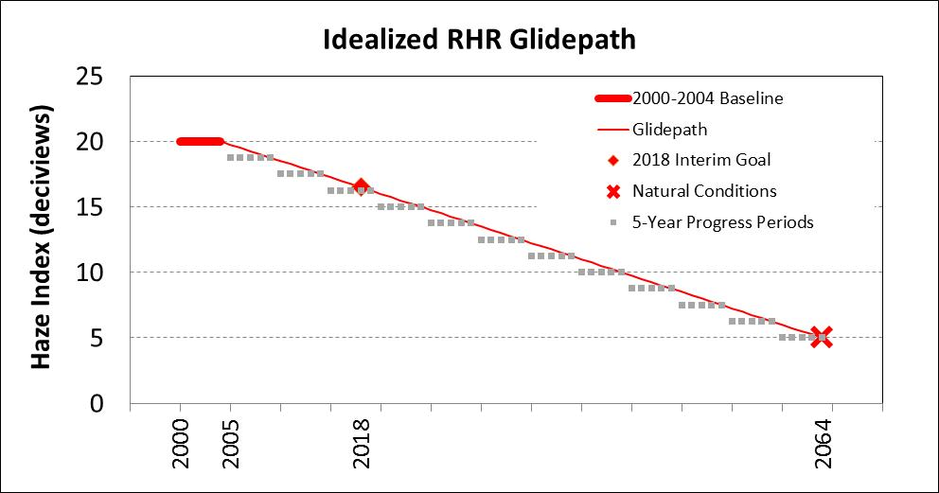
The Regional Haze Rule Glidepath aka Uniform Rate of Progress (URP)
24-hour deciview haze index
Baseline visibility conditions
20% worst versus 20% most impaired
Natural conditions estimate (NCII)
  Adjust for int’l and some fire
Reasonable progress goal (RPG)
  Modeled based on control scenario
(Measured)
(Estimated)
(Estimated)
2028

Slide 6
The Most-Impaired Days Metric
20% worst or haziest days 20% most impaired days
  Statistical removal of effects of extreme episodic events (E3) for carbon and dust
  Acknowledgement of impairment resulting from routine natural emissions
  Remainder is anthropogenic
  Re-sort based on ratio of anthropogenic/natural impairment to identify 20% most impaired days
Focus on reduction of visibility impairment due to anthropogenic emissions
20% best or cleanest days

Slide 7
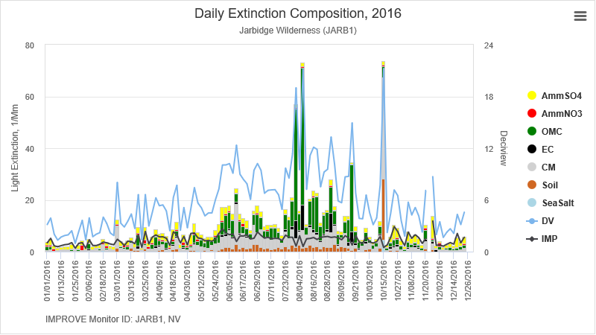
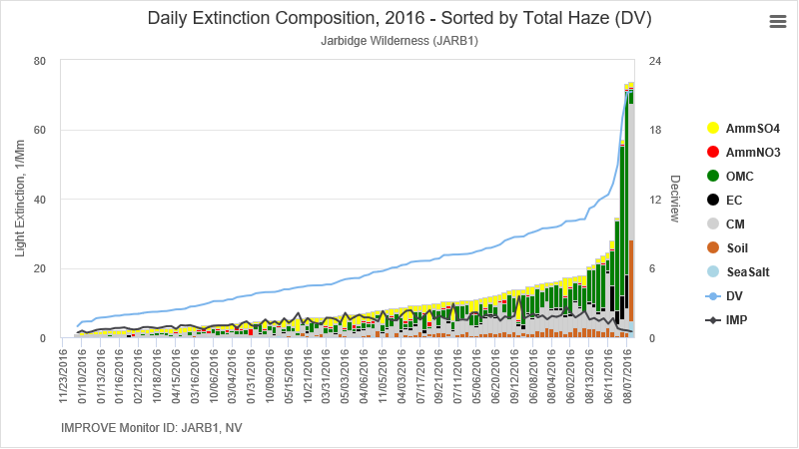
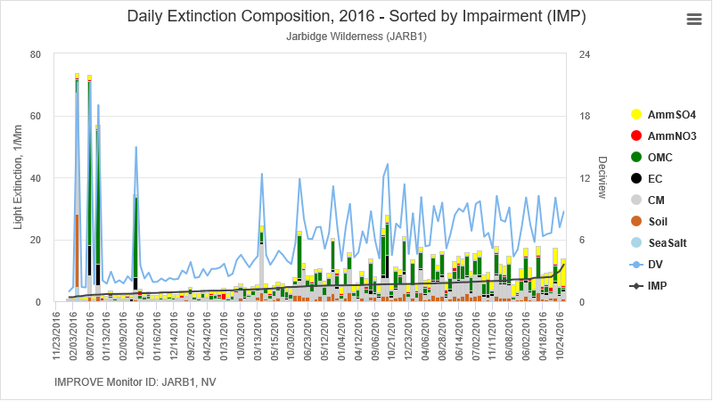
Sorting Comparison
All Sample Days
Haziest Days
Most Impaired Days

Slide 8
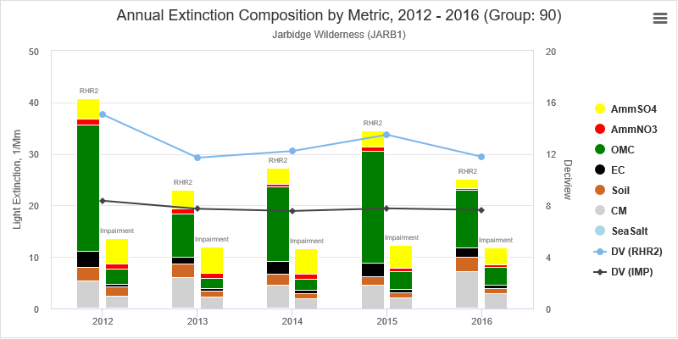
Changes to Annual Averages

Slide 9
E3 Threshold Evaluation

Slide 10
Monitoring Data & Glide Path Subcommittee Update:
E3 Threshold Analysis
Ryan Templeton
8/1/2018

Slide 11
Extreme Episodic Events (E3)
EPA’s proposed threshold to isolate extreme dust (i.e. dust storms) and carbon events (i.e. wildfires)
These can essentially be thought of as exceptional events; however, their identification/treatment is much different
These events will be highly variable between sites and years

Slide 12
EPA’s recommended E3 approach
Raw Data
Carbon = OM + LAC
Dust = CM + Fine
Determine annual 95% carbon and dust values
Threshold = minimum annual extinction between 2000-2014
Natural “episodic” = daily extinction in excess of threshold
PM species extinction estimation
Thresholds are estimated for carbon and dust separately
E3 threshold only targets extreme events, not all events
Treatment does not include removal of E3 days but attempts to remove extreme event emissions in excess of the threshold

Slide 13
Work Completed to Date
Surveyed States for Most Impaired Day (MID) feedback
Identified representative sites for technical analyses
Created a list of metric alternatives with pros/cons
Constructed analytical tools to examine E3 alternatives
Developed graphics and summary charts for 2000-2016 representative site progress
Graphically compared site sensitivity to alternative E3 threshold approaches
Began drafting a subcommittee work summary document

Slide 14
Representative Site Selection
Criteria | Primary Choice | Secondary Choice | Reasoning
Grand Canyon | GRCA (AZ) | N/A | Historical significance
High Impact Fire | YELL (WY) | YOSE (CA) | Complete data at YELL, consistent impacts from fires year after year with extreme days every couple years. YOSE has fires but also days with very high sulfates, could be a good example to see if high non-fire sulfate days remain.
High Impact Dust | SAWE (AZ) | SACR (NM) | Both sites represent regions with high incidences of large dust storms. Additionally, these sites register some of the highest CM visibility impacts of any sites in the West.
Border Site - Canada | GLAC (MT) | MELA (MT) | Proximity to border
Border Site – Mexico | CHIR (AZ) | AGTI (CA) | Proximity to border
Border Site - Other | SIME (AK) | TUXE (AK) | Close to Asia with low local anthropogenic impacts
High Elevation Site | WHRI (CO) | WHPE (NM) | 1st and 2nd highest elevation sites
Coastal Site | REDW (CA) | KALM1 (OR) | REDW has significant sea salt contribution, each day. KALM represents the same region as REDW but is further from the shoreline and exhibits lower sea salt impacts.
Urban Area | ROMO (CO) | SAGO (CA) | Denver and Los Angeles impacted locations, respectively.
Desert | GUMO (NM) | SAWE (AZ) | SAWE and GUMO represent Sonoran and Chihuahuan deserts, respectively
Forest | STAR1 (OR) | NOCA (WA) | Highly forested regions
Tundra | SIME (AK) | TUXE (AK) | Located in subarctic tundra
Volcano | HAVO1 (HI) |  | Highly impacted by volcanic activities
Oil and Gas | MELA (MT) | MEVE1 (CO) | Proximity to gas well (MELA is <5km)
Other | GRBA1 (NV) | SAWT1 (ID) | Sites representing locations with minimal urban or oil and gas influences.
Complex sites | CANY (UT) | JOSH (CA) | CANY has high fire days, high dust days, and many days with high sulfate/nitrate contribution. Source apportionment shows a high percentage from outside domain as well.

Slide 15
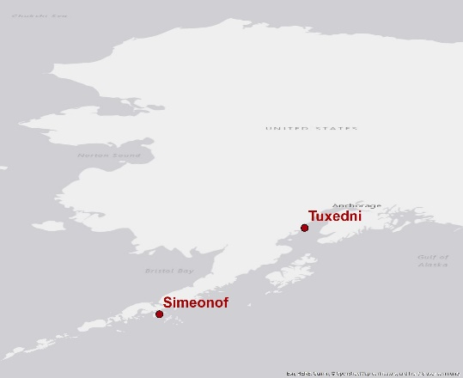
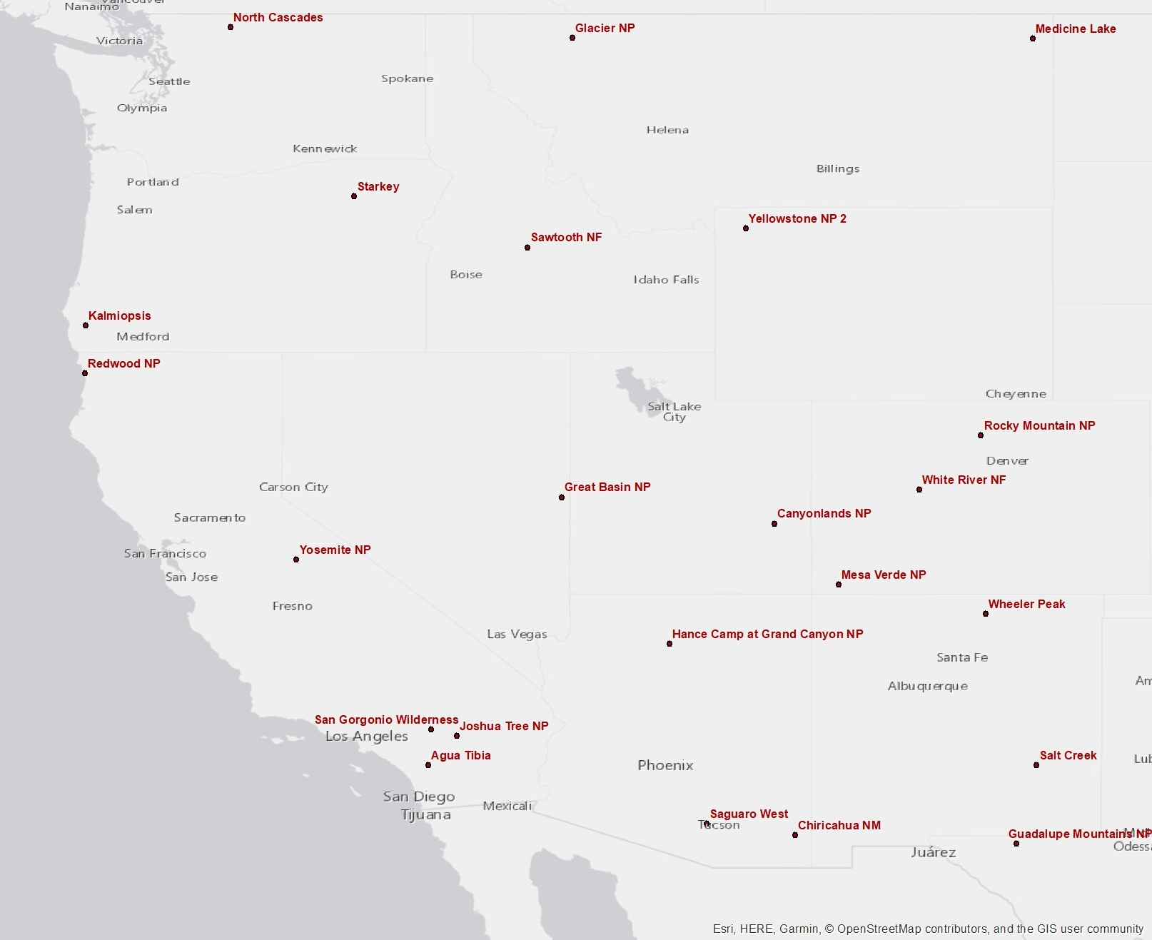
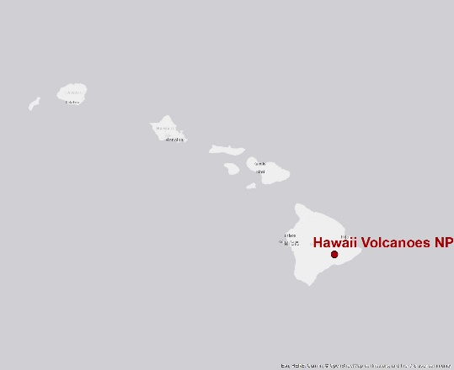
Representative Sites

Slide 16
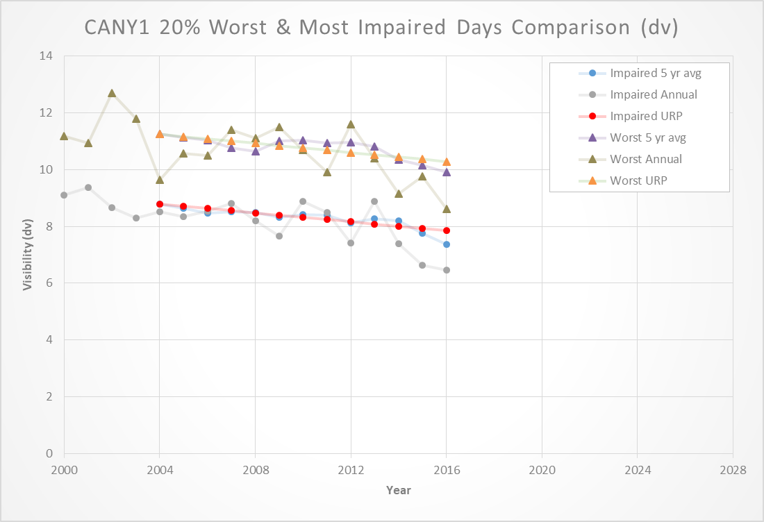
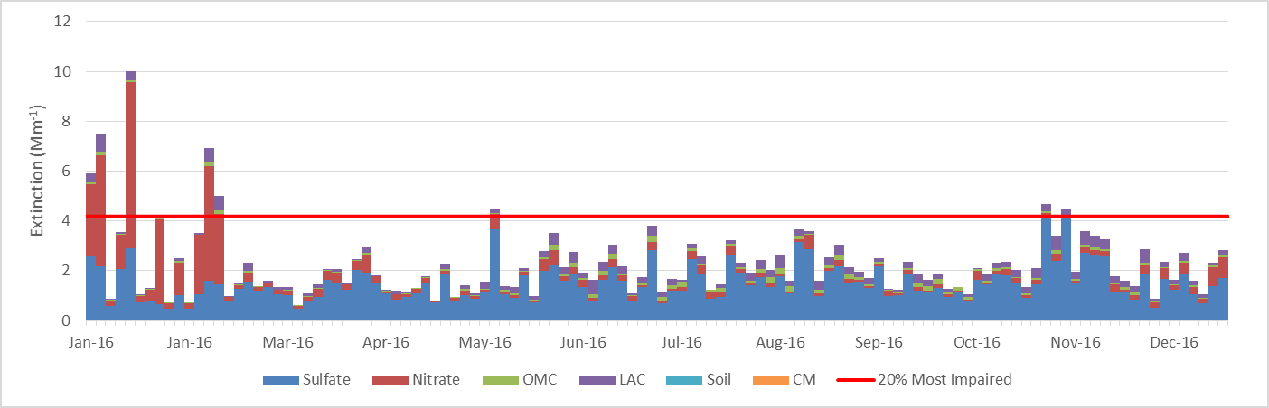
Analytical Tools Developed – Excel Workbook

Slide 17
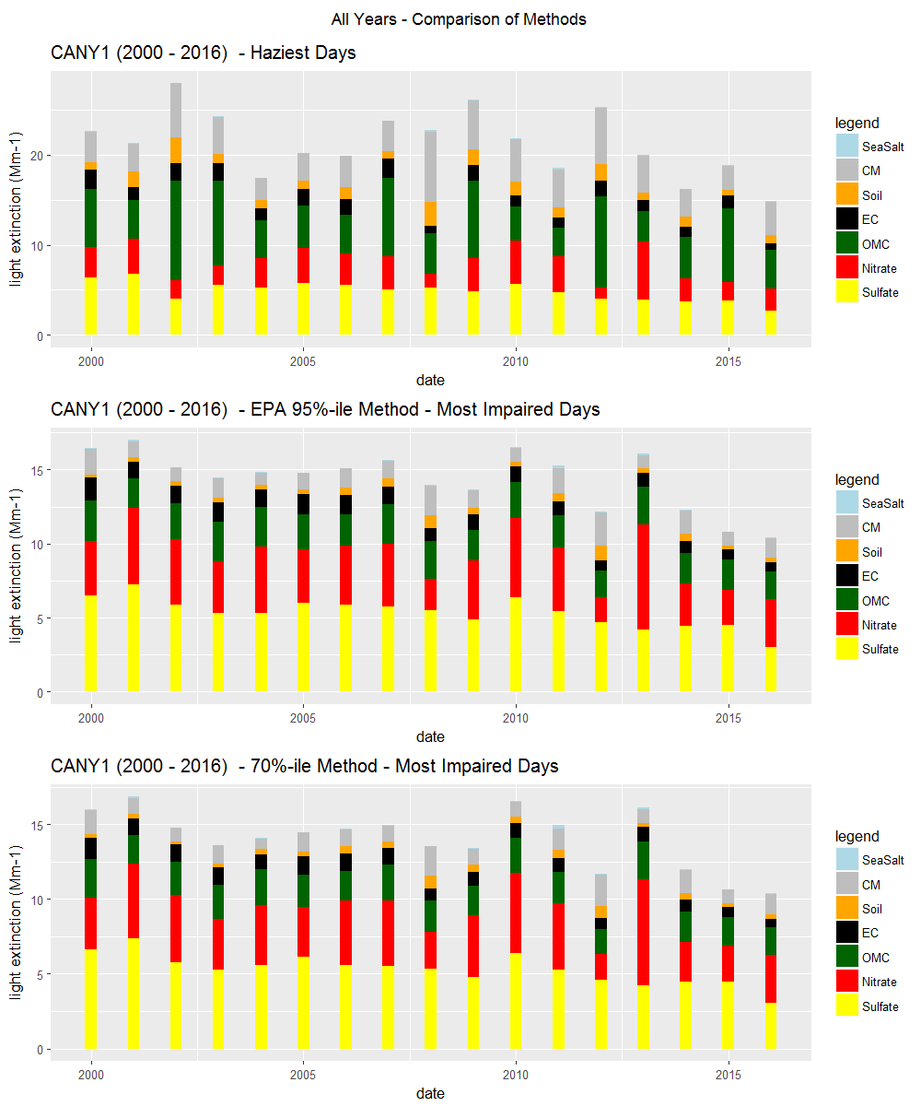
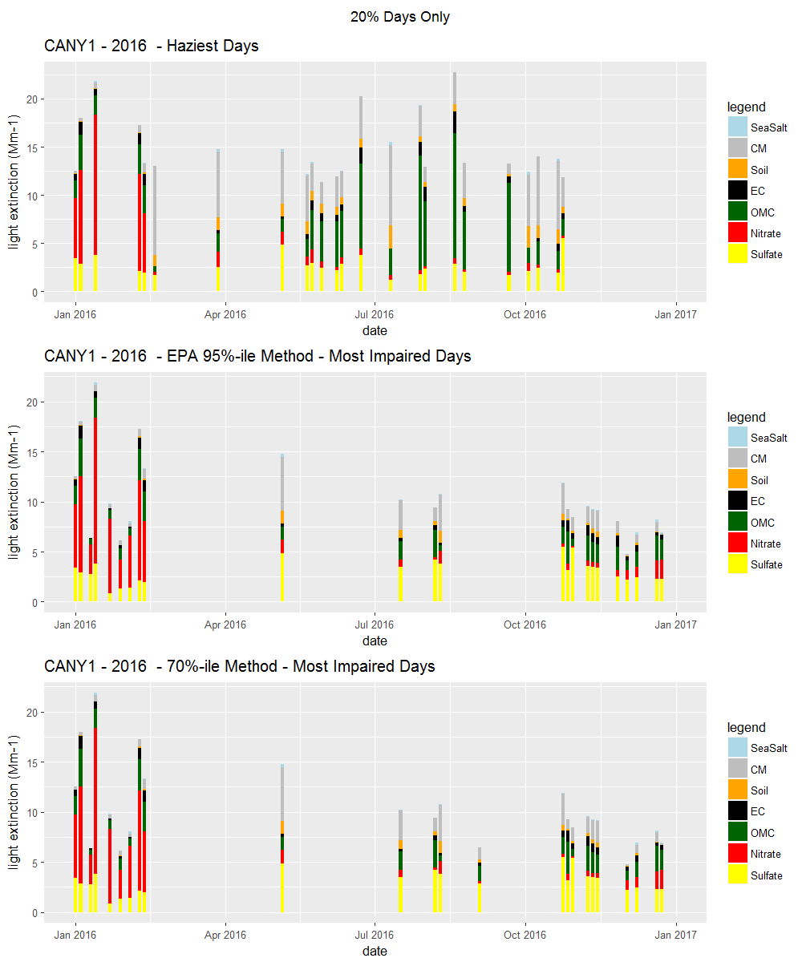
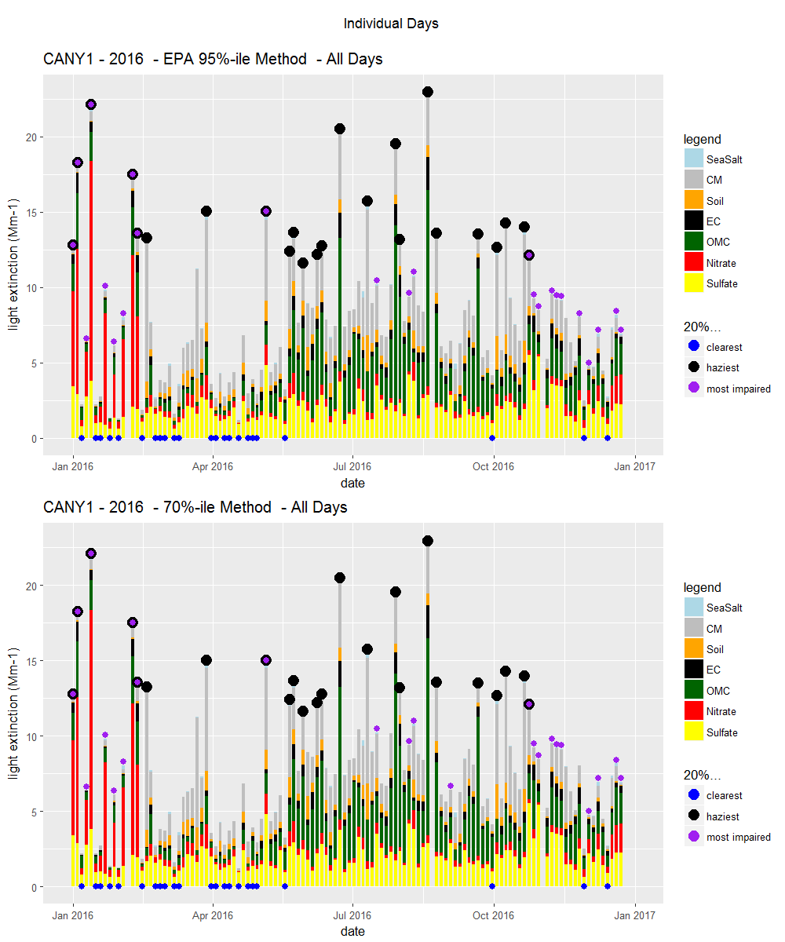
Analytical Tools Developed – R Code
Thresholds Approaches Examined:
Percentiles – 50%, 60%, 70%, 80%, 90%, 95%
Statistics – Minimum, Median, Mean
Temporal Scale – Seasonal, Annual

Slide 18
Threshold alternative comparison
*n = 26 representative monitoring sites

Slide 19
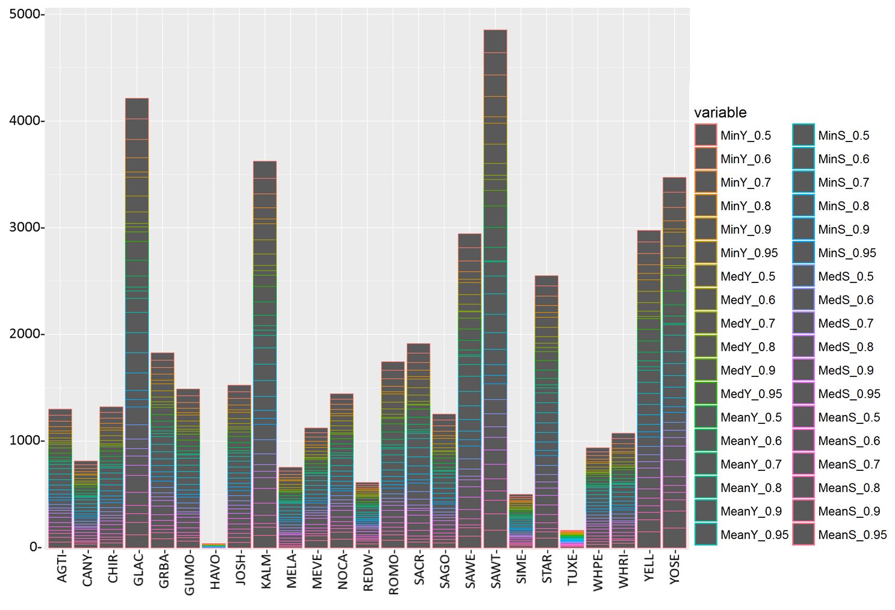
Site Sensitivity
Variable Key:
Statistic - ‘Min’ = Minimum, ‘Med’ = Median, ‘Mean’ = Mean
Temporal Scale – ‘Y’ = Annual, ‘S’ = Seasonal
Threshold Percentiles – 50%, 60%, 70%, 80%, 90%, 95%
High inter-site variability in MID chosen
Large bars indicate sensitivity to changing the MID estimation technique
Variability indicates that sensitive sites should be further analyzed by responsible State
Cumulative Days
Site
*36 MID alternatives tested, sample period is 2000-2016

Slide 20
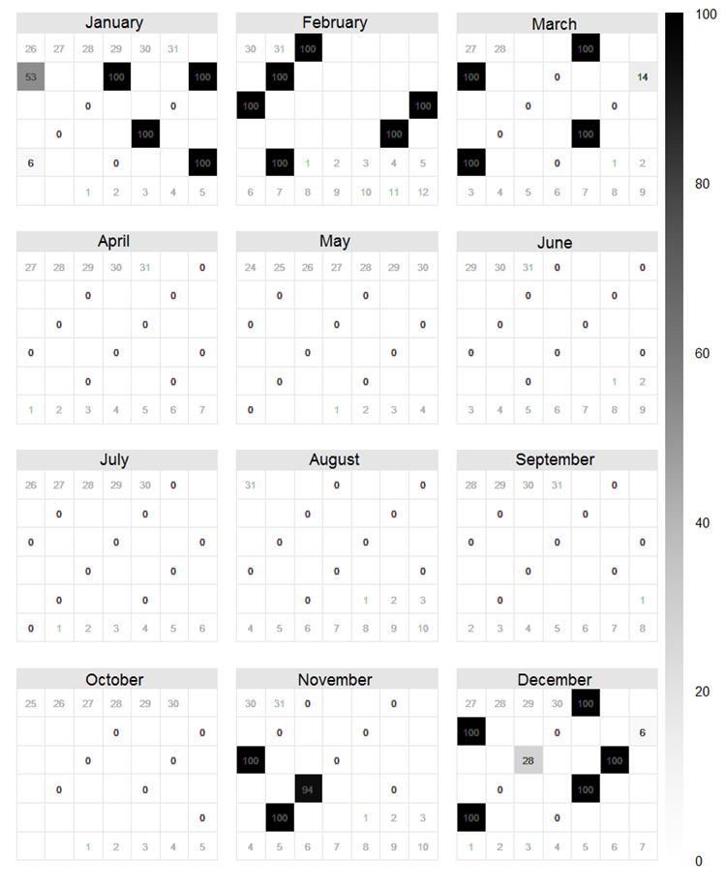
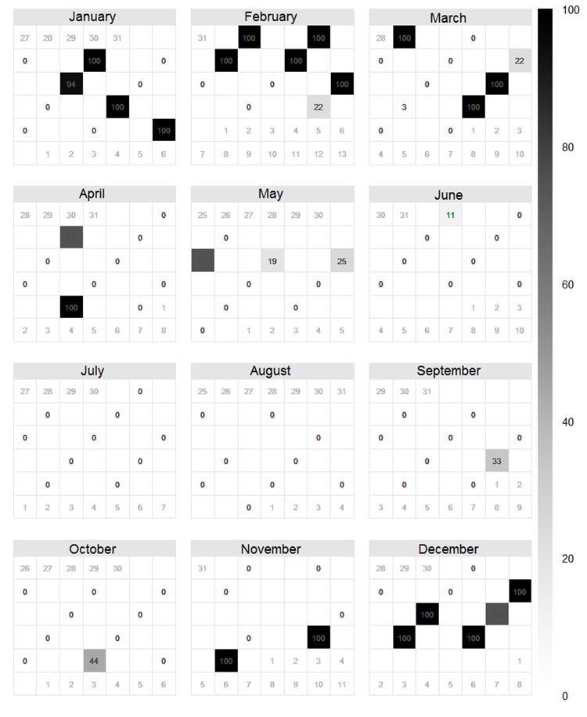
Intra-annual & Inter-annual Variation
% of times days are chosen as MID across 36 threshold alternative scenarios (2010 and 2015) – Medicine Lake, MT

Slide 21
Conclusions to Date
For most sites, EPA’s proposed metric performs adequately for removal of E3 days.
Some sites still may need additional analysis by individual States.
The Monitoring subcommittee needs to coordinate with the Emission Inventory and Modeling subcommittee to determine the impacts of EPA’s proposed metric on modeling.

Slide 22
Upcoming Tasks
Identify criteria by which individual States can evaluate the appropriateness of utilizing a method different from the subcommittee’s recommended approach.
Document coordination recommendations with other States, WESTAR, EPA, etc. for those States who deviate from the subcommittee’s recommended approach.
Coordinate with the EI and Modeling subcommittee to discuss appropriate metrics for modeling purposes.
Evaluate natural condition recommendations and international emission and fire related URP corrections.
Establish regional procedures for missing data substitution.

Slide 23

Upcoming Deadlines
October: Data substitution site
December: Remaining deliverables
  Note: TSS2 datasets are not final until Monitoring Subcommittee deliverables are complete

Slide 24
Natural Conditions Estimates

Slide 25
Natural Conditions Assumptions for First Regional Haze Planning Period
From WRAP teach in #2 presentation (July 27, 2017) by Marc Pitchford: http://www.wrapair2.org/RHPWG.aspx
  Natural conditions for the 2064 endpoint are intended to represent conditions that would exist without man-made visibility impacts
  Nature Haze emissions tend to be highly episodic and unpredictable, so even multi-year average levels can be highly variable and difficult to model.
  Natural Haze emissions often produce PM that are indistinguishable from made-made sources, so they are hard to recognize using monitoring data.
  PM can be composed of a combination of materials from natural and man-made emissions.
  Man-made emissions from foreign emission sources are not controllable by states or federal government, nor are they “natural”.

Slide 26
Natural Conditions Assumptions for Second Regional Haze Planning Period
Natural contributions to aerosol extinction are operationally defined
  Episodic Extreme Events (E3) from carbon and dust
  Routine natural conditions for all aerosol species
Regional Haze Planning Workgroup’s Monitoring and Glideslope Subcommittee is reviewing assumptions
  So far have looked at E3.
  Just beginning to look at assumptions for routine natural contributions.

Slide 27
Natural Conditions Assumptions for Second Regional Haze Planning Period
Tracking visibility progress on most impaired days is intended to avoid including days in the tracking metric when haze is clearly dominated by an episodic extreme event
  Episodic Extreme Events (E3) are not intended to identify all possible contributions from fire or dust
  Routine natural contributions are calculated for all aerosol species
  Most impaired days have the highest fractions of anthropogenic contributions (operationally defined)
  Natural haze contributes to most impaired days.

Slide 28
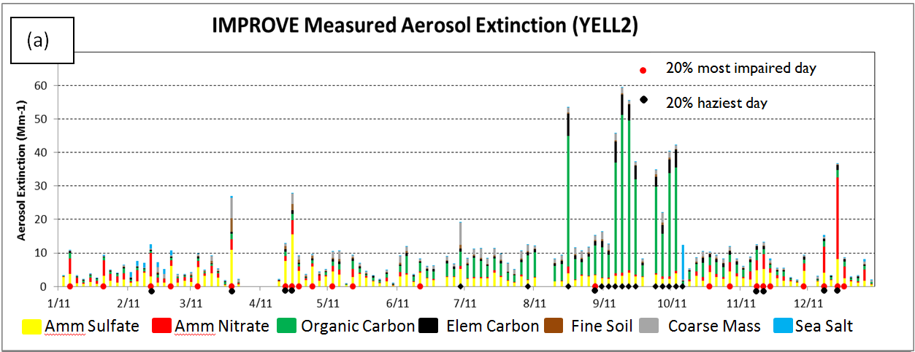
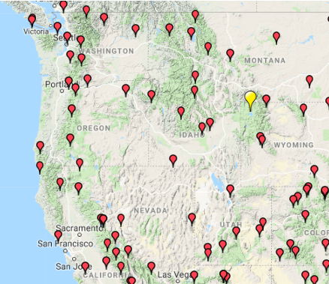
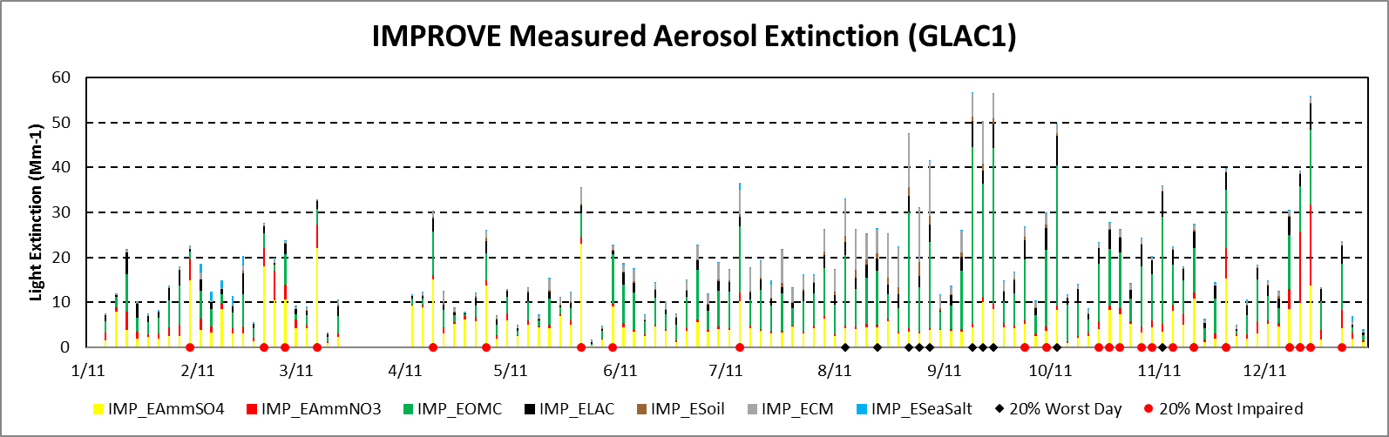
From WRAP Regional
Haze Presentation
April 13, 2018
http://www.wrapair2.org/RHPWG.aspx
GLAC1
YELL2
Haziest days
Most impaired days
Amm Sulfate Amm Nitrate Organic Mass Elem Carbon Fine Soil Coarse Mass Sea Salt

Slide 29
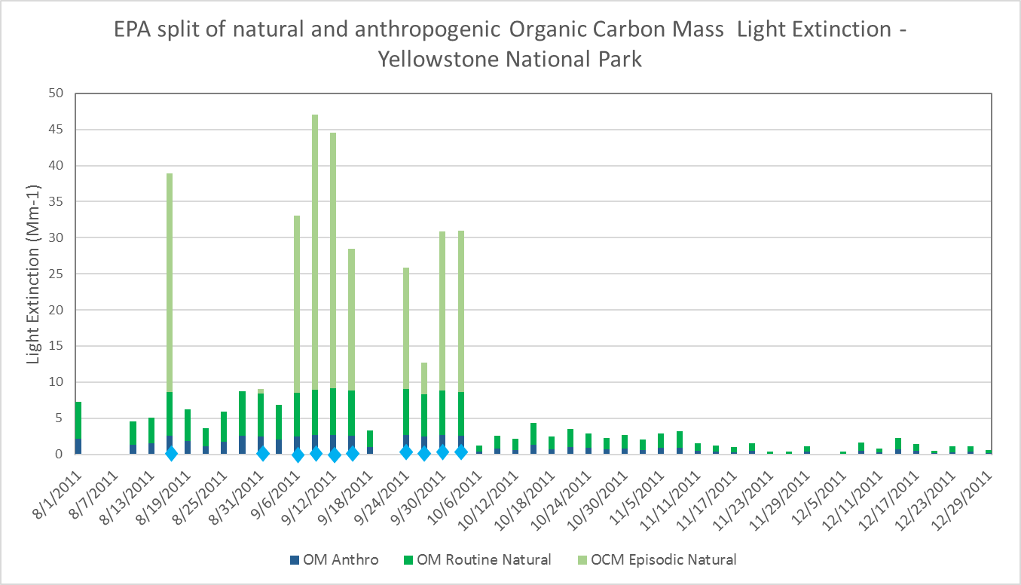
EPA method estimates:
episodic natural, routine natural, and anthropogenic contributions to Organic Mass
Episodic carbon threshold exceeded
Carbon episodic threshold (C3) = 10.1 Mm⁻¹ at YELL
Organic Mass threshold (OM3) = C3 * OM/(OM+EC)
Non-Episodic OM = OM – OM3
Routine Natural OM = non-episodic OM * (ann ave NCII OM/ann ave OM)
Anthro OM = Non-episodic OM – Routine Natural OM
Haziest Days
Most Impaired Days
OM Episodic Natural

Slide 30
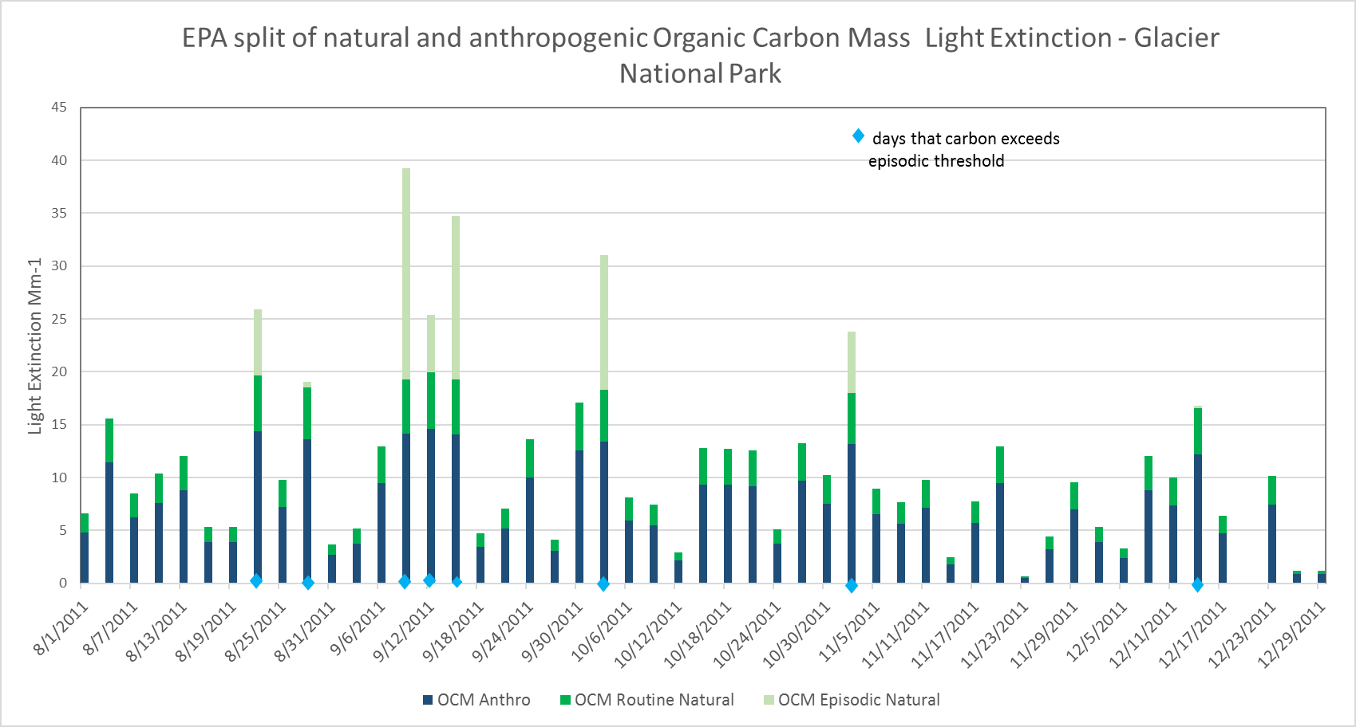
Yellowstone National Park
Episodic carbon threshold:
higher for Glacier NP (22.2 Mm⁻¹) than for Yellowstone NP (10.1 Mm⁻¹).
Fraction of non-episodic OM that is
assigned as routine natural:
smaller for Glacier NP than for Yellowstone NP.
Less OM assigned as episodic
natural and routine natural, and
more OM assigned as anthropogenic at Glacier NP than at Yellowstone.
Episodic carbon threshold exceeded
OM Episodic Natural
Glacier National Park
Episodic carbon threshold exceeded
OM Episodic Natural

Slide 31
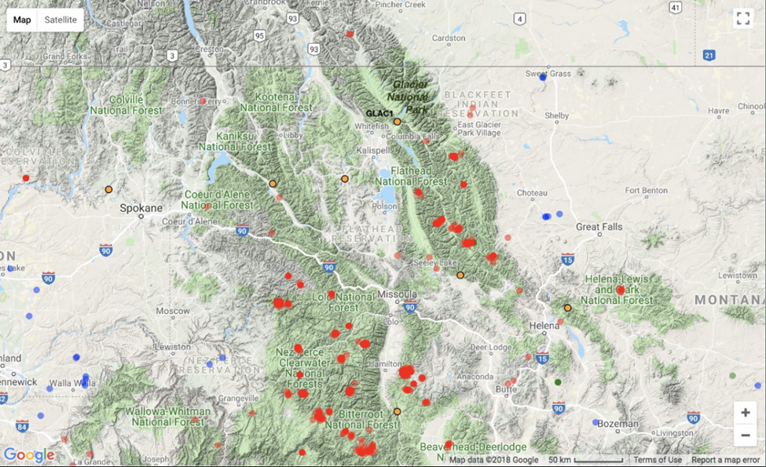
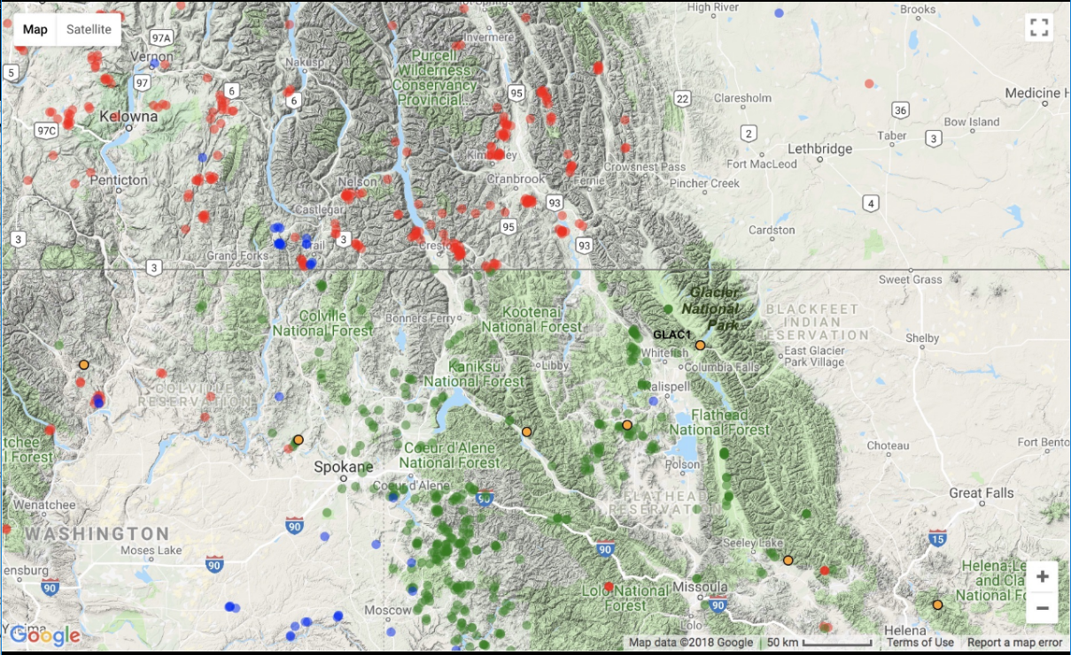

Fire activity data confirm fire events on days exceeding EPA’s episodic carbon threshold
IMPROVE monitor location at Glacier National Park
Wildfires (red circles) and agricultural fires
(blue circles) near Glacier NP from 9/9 to 9/15/2011
b) Prescribed fires (green circles), wildfires (red circles),
and agricultural fires (blue circles) near Glacier NP
from 10/31 to 11/2/2011
www.wraptools.org

Slide 32
Natural Conditions 2064 Endpoint
Natural Conditions 2064 Endpoint anchors the uniform rate of progress glideslope from the 2000-2004 baseline
First Regional Haze Planning Period
  2064 Endpoint Natural Conditions on 20% Haziest Days same as for 2000-2004 baseline.
  3-5 years of observations (depending on data completeness)
Second Regional Haze Planning Period
  2064 Endpoint Natural Conditions on 20% Most Impaired Days same as 2000-2014 average.
  10-15 years of observations (depending on data completeness)

Slide 33
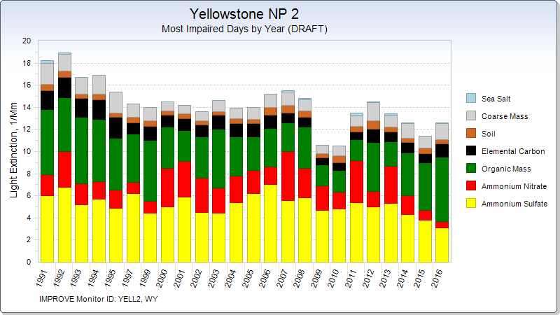

Slide 34
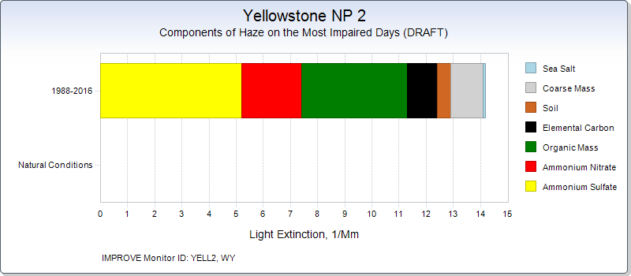
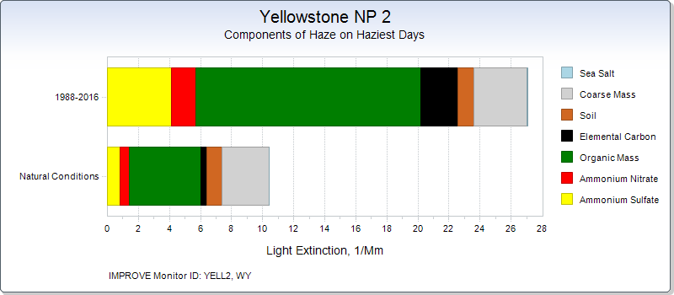
2000-2014
Note: Natural Conditions hand drawn for this example; TSS2 has not yet developed these graphics.
Monitoring and Glideslope Subcommittee and Shared Database Subcommittee could
request alternative years be displayed
2000-2004

Slide 35
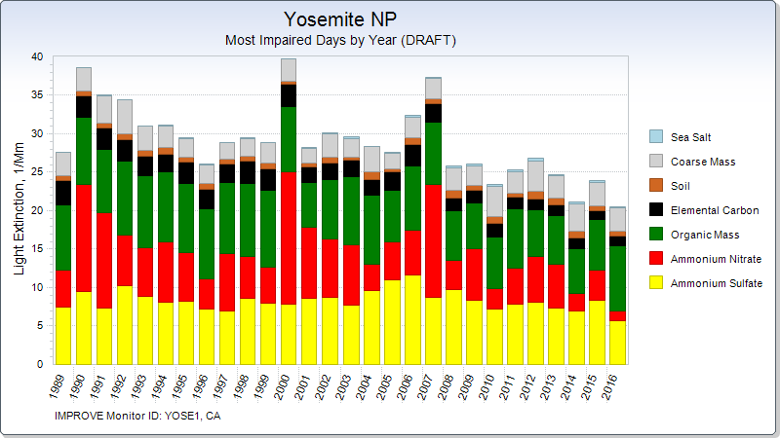

Slide 36
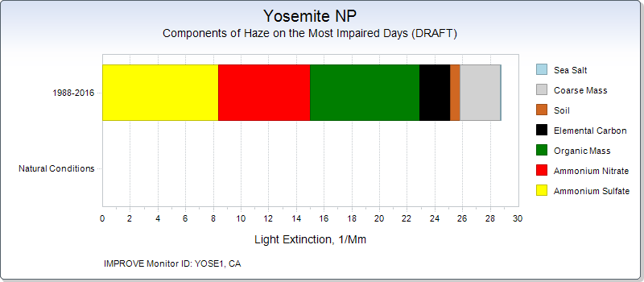
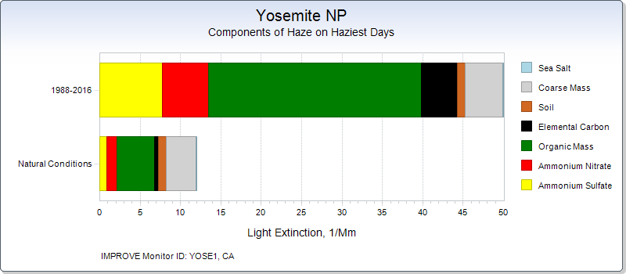
2000-2014
Note: Natural Conditions hand drawn for this ppt; TSS2 has not yet developed these graphics
2000-2004

Slide 38
Monitoring and Glideslope Subcommittee is just beginning to look at glideslope using most impaired days

Slide 39
Adjusting for International and Prescribed Fire Contributions

Slide 40
States can propose methods to account for contributions from international emissions or prescribed fire emissions to natural conditions on the most impaired days
Constant International impairment
 |  |  |  |  | Sum total haze for plotting URP
Year | Natural | Int Anthro | US Anthro |  | Year | Natural | Int Anthro+Natural | Old URP | URP Constant Int
2004 | 3.00 | 4.00 | 5.00 |  | 2004 | 3.00 | 7.00 | 12.00 | 12.00
2011 | 3.00 | 4.00 | 4.42 |  | 2011 | 3.00 | 7.00 | 10.95 | 11.42
2016 | 3.00 | 4.00 | 4.00 |  | 2016 | 3.00 | 7.00 | 10.20 | 11.00
2028 | 3.00 | 4.00 | 3.00 |  | 2028 | 3.00 | 7.00 | 8.40 | 10.00
2064 | 3.00 | 4.00 | 0.00 |  | 2064 | 3.00 | 7.00 | 3.00 | 7.00
Assume constant natural haze and vary the international transport contribution to impairment
Progress in reducing U.S. impairment is identical whether we use constant or variable international impairment
 |  | edit International here |  |  | Sum total haze for plotting URP
Year | Natural | Int Anthro | US Anthro |  | Year | Natural | Int Anthro+Natural | URP variable Int | URP Constant Int
2004 | 3.00 | 4.00 | 5.00 |  | 2004 | 3.00 | 7.00 | 12.00 | 12.00
2011 | 3.00 | 5.50 | 4.42 |  | 2011 | 3.00 | 8.50 | 12.92 | 11.42
2016 | 3.00 | 4.50 | 4.00 |  | 2016 | 3.00 | 7.50 | 11.50 | 11.00
2028 | 3.00 | 3.50 | 3.00 |  | 2028 | 3.00 | 6.50 | 9.50 | 10.00
2064 | 3.00 | 2.00 | 0.00 |  | 2064 | 3.00 | 5.00 | 5.00 | 7.00

Slide 41
What analyses are planned to address international contributions or prescribed fire contributions?
FSWG contractor-supported Workplan tasks:
  evaluation of the 2014 fire NEI, evaluation of adjustments for sensitivity testing to improve model performance;
  using 2014 year-specific fire inventory to develop fire inventory representative of 5-year (2013-17) baseline; and
  scaling the representative baseline inventory for future-year (~2028) sensitivity testing of modeled visibility and ozone responses
Update on EPRI International Contributions to Haze project – April 24, 2018 WESTAR-WRAP meeting presentation
  Global modeling work: separate Natural and Anthro, sensitivity runs to evaluate results at U.S. Class I areas
  2016 collaborative Emissions Modeling Platform to be basis of U.S. regional model for EPRI efforts
  2028 Global Modeling scenario with all anthropogenic emissions outside U.S. set to zero (Zero out Rest of World or ZROW)
No plans at this point for evaluation of U.S. natural emissions of dust or any other natural visibility-impairing species / source categories
  Could assess ammonia, but a large and complex project

Slide 42
Regional Technical Contract Support

Slide 43
Contract support as of Aug. 1, 2018
Complete
  OGWG - Road Map Phase 1
  RTOWG - Modeling Representativeness Analysis
  FSWG - support for Workplan task planning
Underway
  OGWG - Road Map Phase 2 (runs 2018-19)
Award Imminent
  TDWG - support for Workplan tasks and Regional Haze planning (to run 2018-19)
  FSWG - technical support for Regional Haze planning and other FSWG tasks (to run 2018-19)
  Western States’ Regional Haze Planning Readiness Assessment project for RHPWG (WRAP staff manage, finish by Nov. 2018)
  IMPROVE Data Analysis for all Class I areas for RHPWG Monitoring Data & Glideslope / Shared Database Subcommittees (WRAP staff manage, finish first phase by Nov. 2018)
Modeling Platform
  schedule as discussed earlier (to run 2018 - early 2020)

Slide 44
Next Steps

Slide 45
Next Steps
Engage with Monitor Data and Glideslope SC
  Review analytical tools and results created by SC to evaluate E3 threshold
  Contribute to work documentation document and most-impaired days (MID) alternatives
  Continued MID evaluation focused on routine natural conditions and end point natural conditions
Evaluate the MID monitor data on TSS v2 (when available)
Reach broad consensus on metric
  Special circumstances may warrant special treatment
Visibility and control measures analysis
Resolving the anthropogenic/natural split in monitor and model data

Slide 46
Next TSC/Co-Chairs call
August 29
11:30 am – 1:00 pm PDT

